Slide 1




Cyber Security Breaches Dashboard
Breaches Analysis & Summary

Slide 2


WHAT IS CYBER SECURITY
Cyber Security is the application of
technologies, processes and controls to protect systems, networks, programs, devices & data from cyber attacks.
It aims to reduce the risk of cyber attacks and protect against the unauthorised exploitation of systems, networks & technologies

Slide 3



About the use case
To develop the basic understanding of analysis of the Cybersecurity breaches occurred in the past and how many breaches are currently open, Number of employees are affected by it and the types of Breaches

Slide 4
ANALYTICS PROJECT LIFE CYCLE
The 6 Phases
UNDERSTAND & PLAN
Translate the business question to analytics question
DATA
Work cross functionally to gather and process
data
ANALYSIS
Solve problems
PRESENTATION
Present results and tell a story
DOCUMENTATION & REFLECTION
Make your project a happy ending
MODIFICATION
Take feedbacks and modify/improve your
presentations

Slide 5


DASHBOARD MAIN COMPONENTS
Employee
Ranking
Branch
Analysis
Providing Ranking of the Employee who solved most breaches
Providing Insight of the Branches where Breaches occur more
Home Page
Department Analysis
Summary
Showcasing the high level KPIs and redirection to other sub pages
Summary table
Providing Insight of the department Breaches occur more

Slide 6
KPI
Total Breaches.
Open Breaches
Closed Breaches Employee Strength AVG Breach End Days
Estimate Stole Data (GB) Affected Employees % Secured Employees % Affected Employees Secured Employees
Find out Breach Employees

Slide 7




DASHBOARD DESIGN

Slide 8


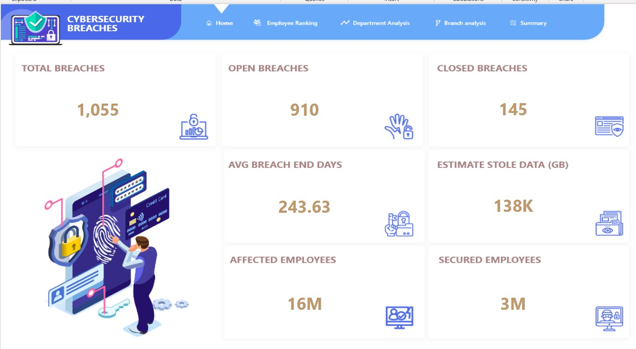



Slide 9


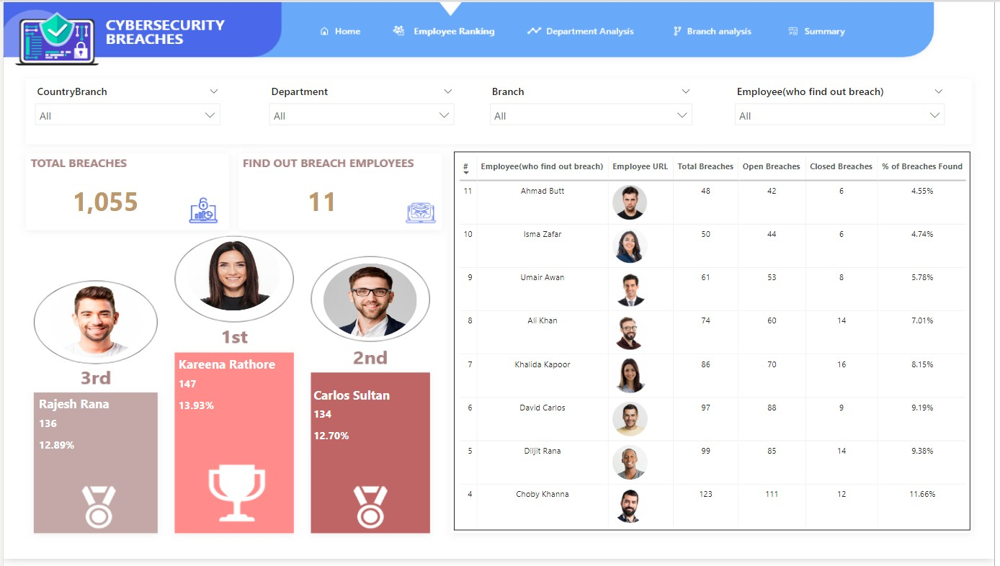



Slide 10
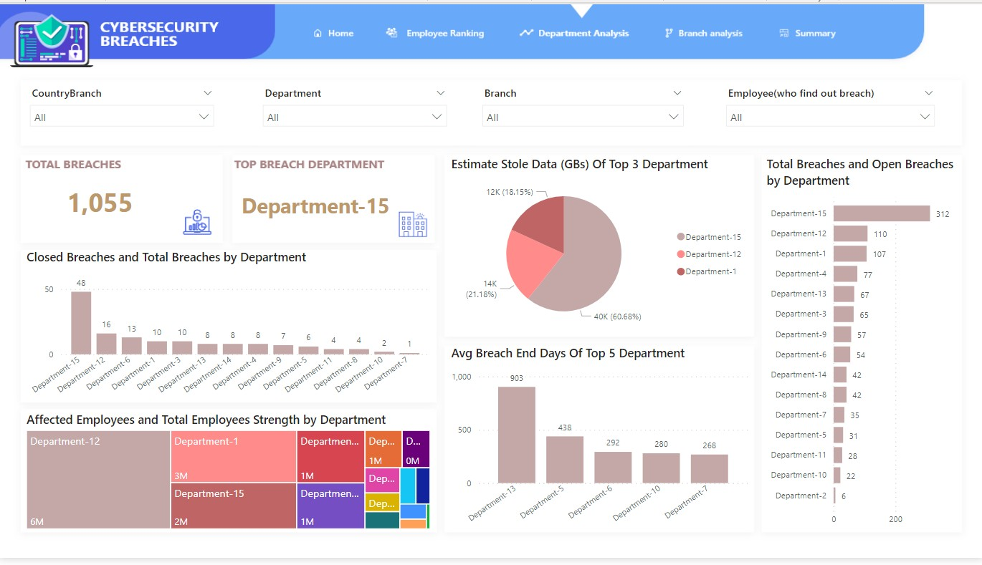

Slide 11
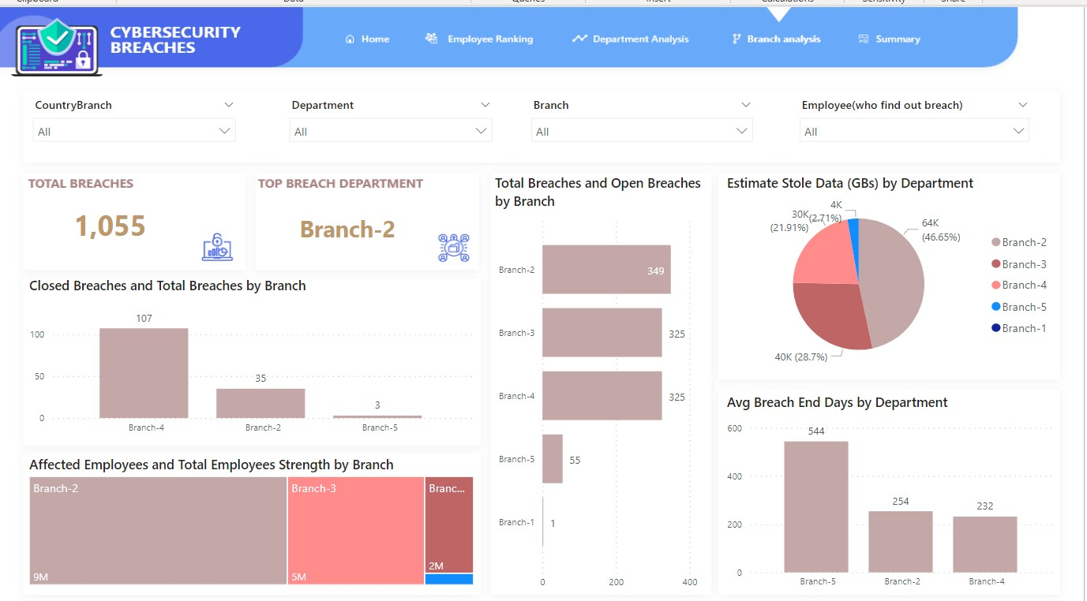

Slide 12
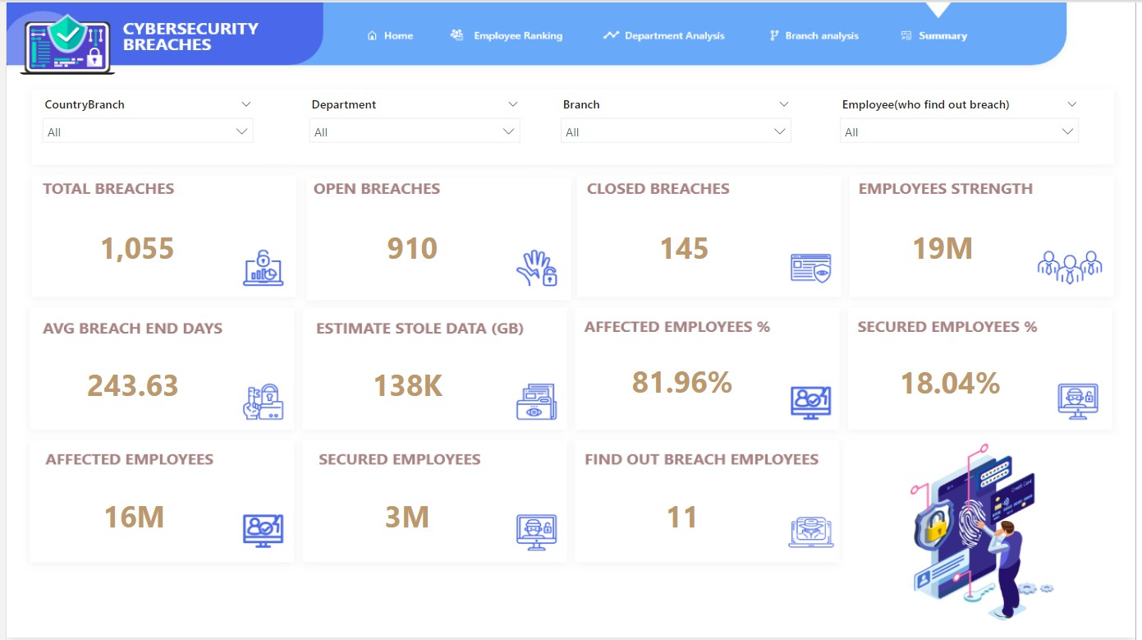

Slide 13


THANK YOU

